Slide 1
Model Initialization for Age Estimation
6210554725
Jakkaphob Kongthanarith

Slide 2
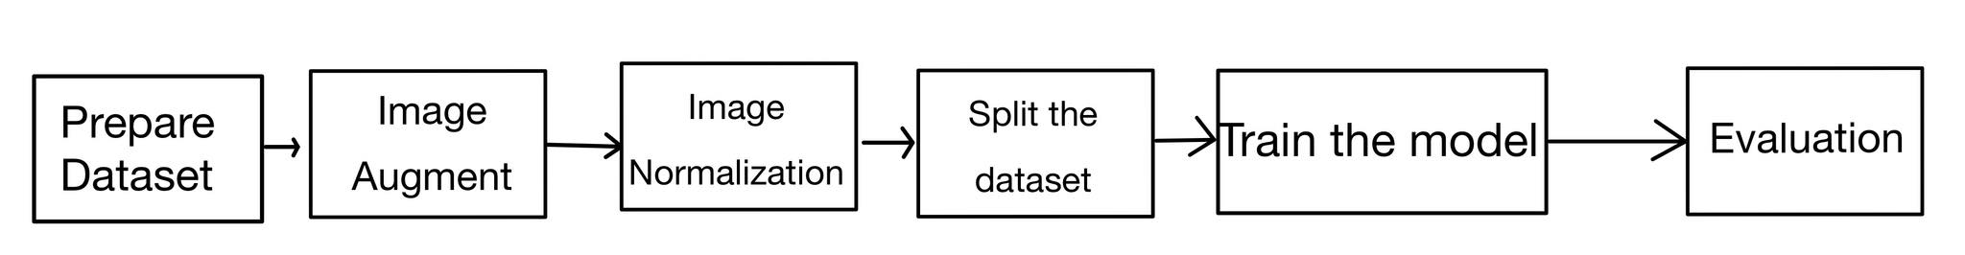
Flow Chart

Slide 3
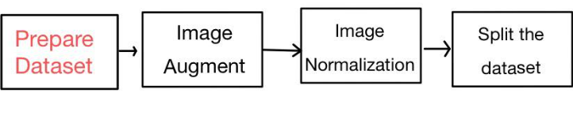
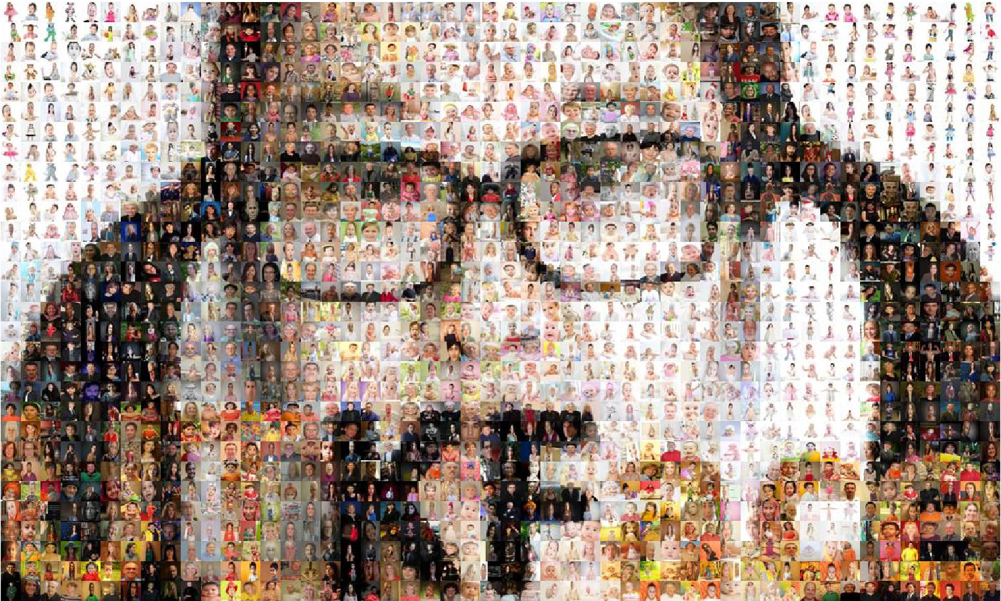

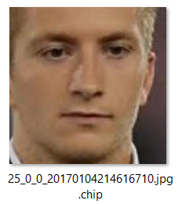
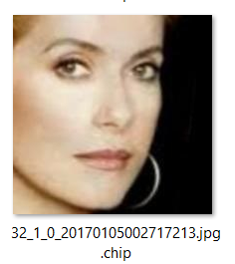
Data sets
Number of files per gender: 25
Age range: 1-79
UTK Face downloaded from Kaggle
Content: Face images
Age range: 0 to 116
Gender: Male and Female
Number of images : 23,708 images
Age_Gender_Ethnicity_Filename.jpg.chip.jpg
https://www.kaggle.com/datasets/jangedoo/utkface-new
Age = 25
Gender = 0 -> Male
Age = 32
Gender = 1 -> Female
Source: https://susanqq.github.io/UTKFace/.
https://www.iconfinder.com/icons/4373210/kaggle_logo_logos_icon

Slide 4
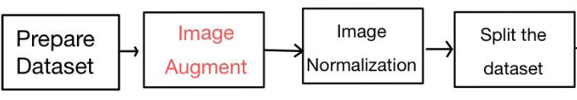
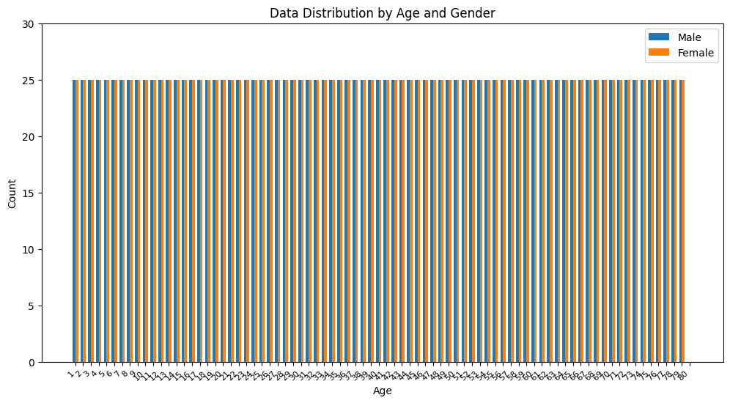
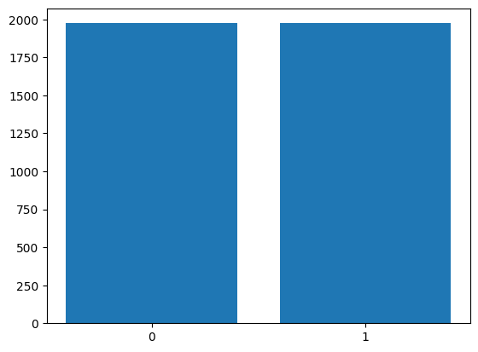
Image Augmentation
If the number of Images for each gender did not reach the maximum count (25) perform an augmentation
Total Samples: 3950
Max value = 1
Max value = 90

Slide 5
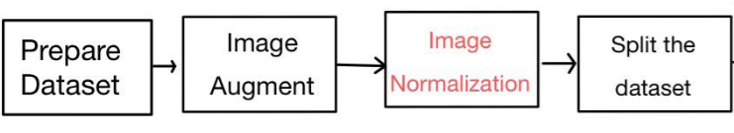


Image Normalization
Normalize the image to be used for Dataset’s features by divide all of pixel values by 255
Faster processing time
better accuracy
A part of pixel values before
Normalization
A part of pixel values After
Normalization

Slide 6
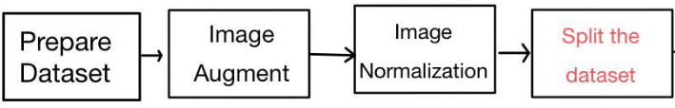


Dataset for Model training
Total images: 3950
Split into Training and Testing Dataset
Ratio for Training and Testing 8:2
Train: 3160 Test: 790
Epoch: 45 Batch size = 20
x train
(Image of an individual person)
y train
(Age of an individual person)
Actual age: 21
Actual age: 46

Slide 7
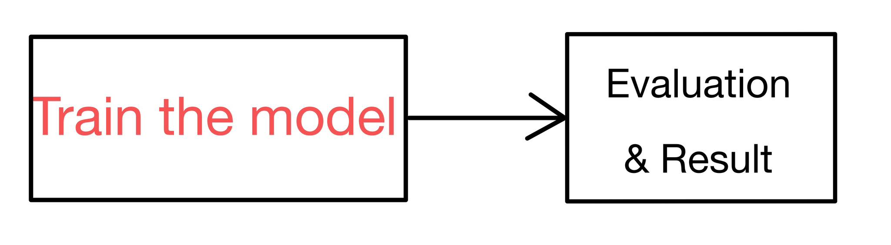
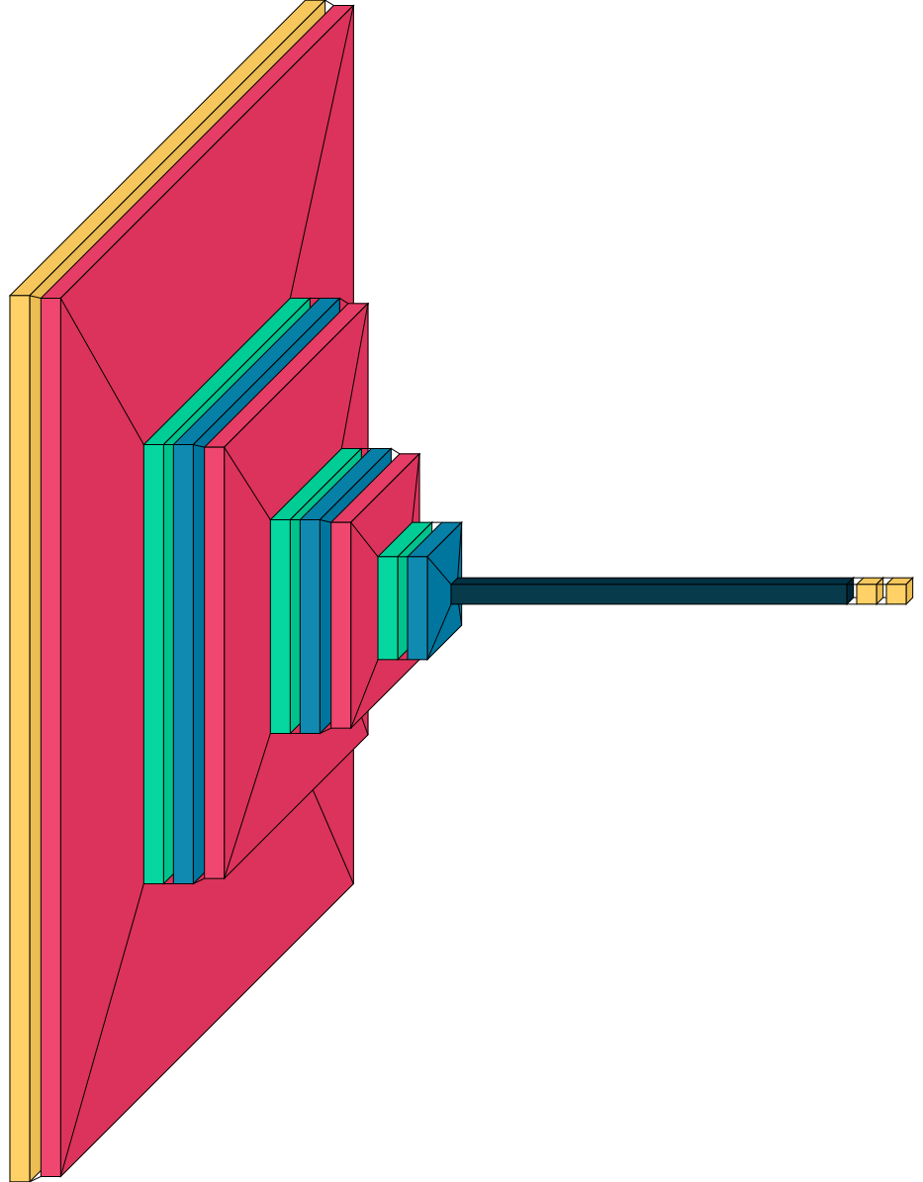
Age Model (CNN)
Input layer
- Numpy.ndarray (224,224,3)
- Color Images
Output layer
- 1 output of estimated age (Linear)
Layer (Type) | Output Shape
Input Layer (224,224,3) | (224,224,3)
Conv2D (filter = 32), (kernelize = 3*3) | (222,222,32)
MaxPooling2D (2*2) | (111,111,32)
Dropout (0.5) | (111,111,32)
Conv2D (filter = 64), Kernel size = 3*3) | (109,109,64)
MaxPooling2D (2*2) | (54,54,64)
Dropout (0.5) | (54,54,64)
Conv2D (filter size = 128) | (52,52,128)
MaxPooling2D (2*2) | (26,26,128)
Dropout (0.5) | (226,226,128)
Flatten | (86528)
Dense (filter = 64) | (64)
Output Layer (activation = linear) | (1)

Slide 8


Age Model Evaluation (Kernel)
n = Total number of files
Xi = Predicted value
X = Actual value
Initialization method | Train MAE | Test MAE | Train Loss | Test Loss
Glorot_uniform (Default for CNN) | 8.5246 | 13.3773 | 119.6415 | 278.9876
Zero | 28.8623 | 28.0063 | 1240.9595 | 1167.8342
Glorot_normal | 9.5571 | 13.7887 | 150.2741 | 289.0040
He_normal | 28.7123 | 29.2987 | 1227.6096 | 1275.9395
He_uniform | 9.2964 | 20.0871 | 137.044 | 606.2070
Random_normal | 28.6285 | 28.9267 | 1222.9497 | 1238.9324
Random_uniform | 8.7701 | 14.0576 | 125.3125 | 329.7053

Slide 9
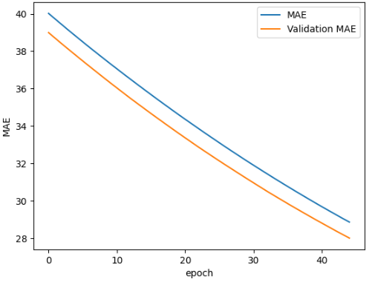
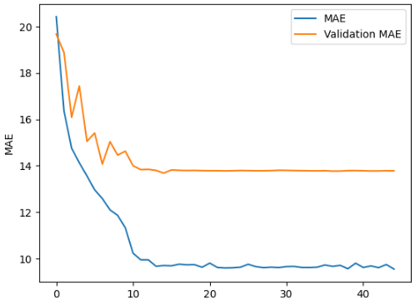
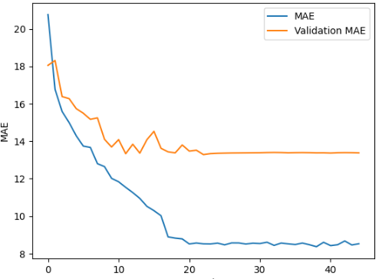
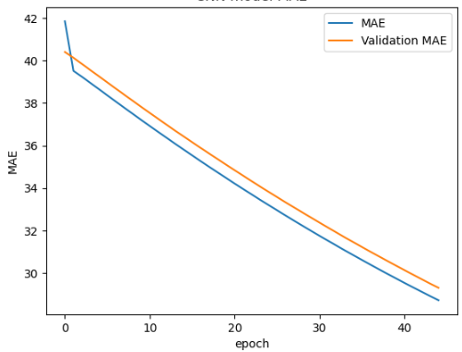
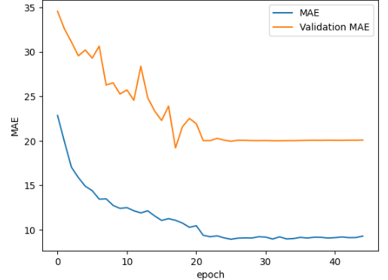
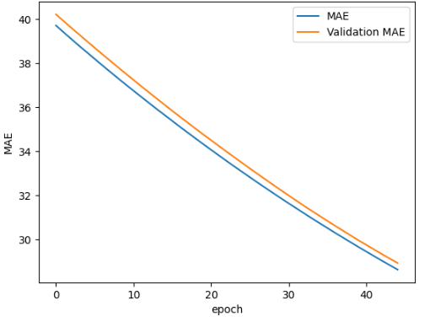
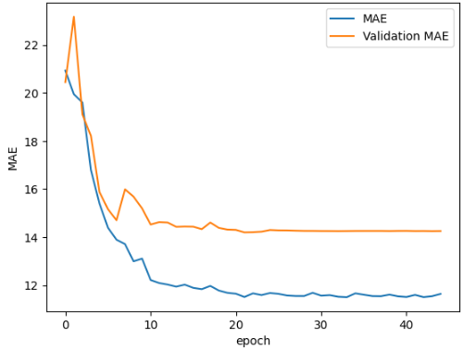
Age Model Evaluation Graph (Kernel)
Zero initialization MAE
Glorot Normal MAE
Glorot Uniform
He_normal MAE
He_normal MAE
Random_normal
Random_Uniform

Slide 10
Age Model Evaluation (Bias)
Initialization method | Train MAE | Test MAE | Train Loss | Test Loss
Zero (Default) | 12.2524 | 16.4194 | 231.6260 | 397.4644
Constant (Manually adjusted) (bias = 0.1) | 13.8253 | 22.1904 | 286.2624 | 706.7732
HE_normal | 37.5159 | 37.8965 | 1951.6508 | 1968.0397
HE_Uniform | 36.4908 | 35.4343 | 1838.8444 | 1774.4475
Random_normal | 10.163 | 14.8020 | 173.1014 | 344.1577
Random_uniform | 11.6425 | 14.2584 | 212.9210 | 312.1348
Best model = Kernel initializer: Glorot Uniform
MAE = 8.5246 Test MAE = 13.3773 Loss = 119.6415 Test Loss 278.9876

Slide 11
Conclusion
Bias will adjust the bias of the model as of it’s name, but since my data set are being equally distributed, adjusting bias only return the worsen result.
When comparing the result of two method, all result from bias is worse than weight, this mean that in my case for age estimation, adjusting the bias will only worsen the result.
The Initialization method with best performance is Kernel Glorot Uniform, which is a default initialization method applied in case no specific initialization method were written.

Slide 12
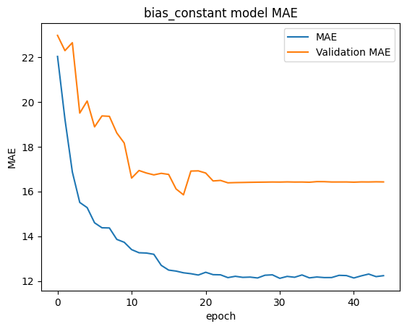
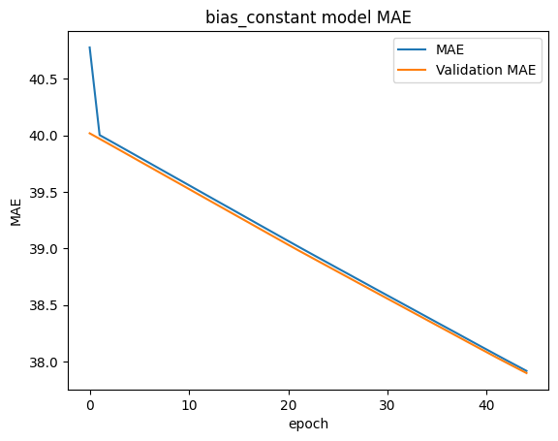
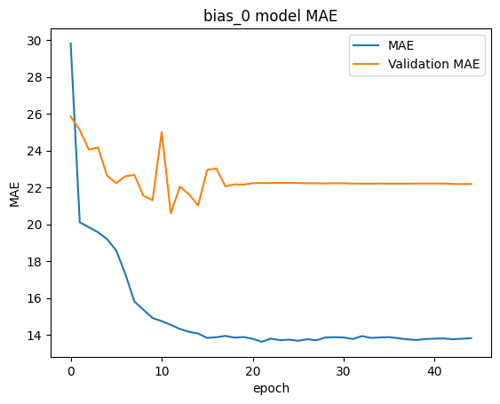
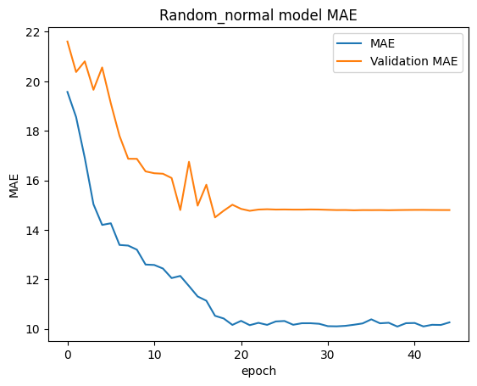
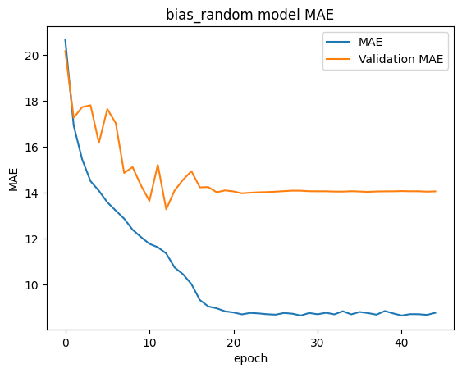
Age Model Evaluation Graph (Bias)
0 initialization MAE
HE Normal MAE
HE Uniform MAE
Constant MAE
Random Normal MAE
Random_Uniform MAE

Slide 13




Age Model prediction
Real | Predict
8 | 37
Real | Predict
32 | 45
Real | Predict
34 | 40
Real | Predict
30 | 30

